Slide 1




THERMAL SCANNING SECURITY SYSTEM
WITH TICKET VALIDATOR
Avinash Kumar
Subham Kumar
Swaraj
Yugank Verma
Presentation by Lazy Bots

Slide 2


What?
Our project is to integrate automatic temperature pass system in heavily congested places like railway stations, malls, temples etc. People are allowed inside only when their body temperature is within the safe temperature range.
This project can be used as a safety measure in daily life by integrating it with instruments like a doorbell or peep hole at homes and thus notifying people inside about the temperature status of the visitor.

Slide 3


HUMAN ERRORS
Why?
Humans cannot constantly work with same efficiency and concentration which lead to errors.
COSTLY FOR DAILY USE
TIME CONSUMING
Other products require some human hand to operate constantly. Hence when salary added to cost product it becomes too expensive.
When same work is done manually it generally takes 20 sec to record temperature and note it down.But with this machine this will take fractions of second.

Slide 4








ARDUNINO UNO
SERVO MOTOR
LCD DISPLAY
ULTRASONIC
SENSOR
TEMPERATURE SENSOR
(MLX90614)
BUZZER
HOW?

Slide 5

AT TEMPLES,MALLS
Can be integrated with metal detectors present at the entrance.
Application
This Automatic Thermal Scanner Pass System can be widely used from home utility to heavily congested places.
AT RAILWAYS STATIONS,AIRPORTS
HOME UTILITY
Temperature data can be linked with individuals ticket data.
Can be integrated with door bells and peep holes in the house.

Slide 6
Future Plans
We can integrate this scanner with an automated gate barrier and ticket validator at locations where ticketing system is installed, through which we can track a covid symptomatic person by linking their body temperature with the ticket data. Along with this, the problem of ticketless travel in Indian Railways can also be solved.
In home utility We can also combine this automated thermal scanner with an AI face recognition.Also a notification can be sent through mobile application about visitors face and temperature
As of now we are not able to add some features due to lack of technical knowledge and unavailability of some components.

Slide 7
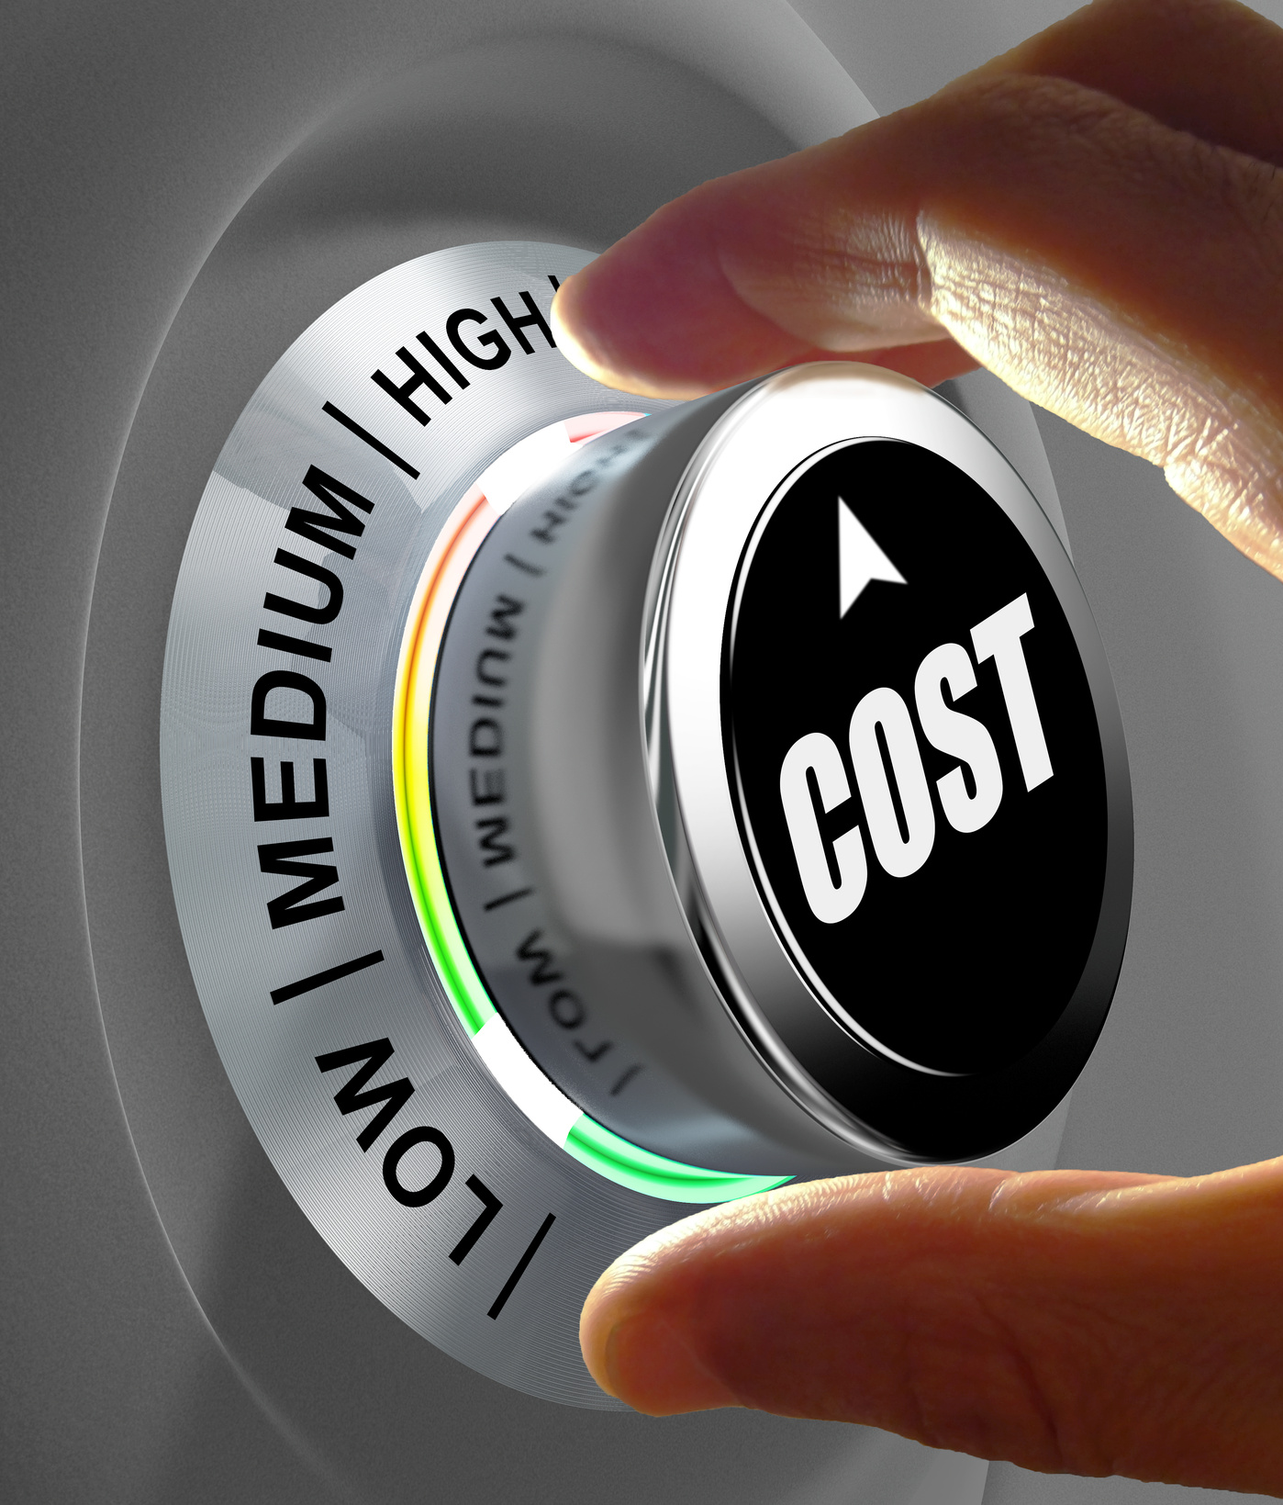
Thermal guns costs around Rs 2000 to Rs 10000.
Overal cost increases when we salaried ( minimum Rs 20000) the human resources for manual working.
For large scale our Automated Security Electric Gate system costs about Rs 50000 and other required components will cost about Rs3000 overall approx Rs 53000 which will be a one time investment.
For home utility our Automated system will cost about Rs 500-700.

Slide 8

Constraints!
And
Solutions
Constraints!
Only one person can pass through the automatic gate at a time, so this may take time if there are a large number of people.
Solution
We can solve this problem by increasing the number of gates and response time of the system.

Slide 9

CONCLUSION
POINT ONE
If we are able to implement this idea then we can reduce the problem of free travel in railways and can also insure our health security.
POINT TWO
By implementing this idea we can overcome problems like high cost, human errors.

